Slide 1

Amazon YTD Sales Analysis
This presentation provides an in-depth analysis of Amazon's year-to-date sales performance. We will explore key metrics, identify trends, and outline strategies for future growth.
KP
by Kaviya Prabha

Slide 2

Project Objectives
Evaluate YTD Sales
Assess overall revenue performance from January 1st to the current date.
Analyze Company Growth
Understand growth trajectories and identify key drivers of expansion.
Identify Product Trends
Pinpoint products with upward or downward sales momentum.
Mitigate Future Risks
Develop data-driven strategies to reduce potential risks in upcoming years.

Slide 3
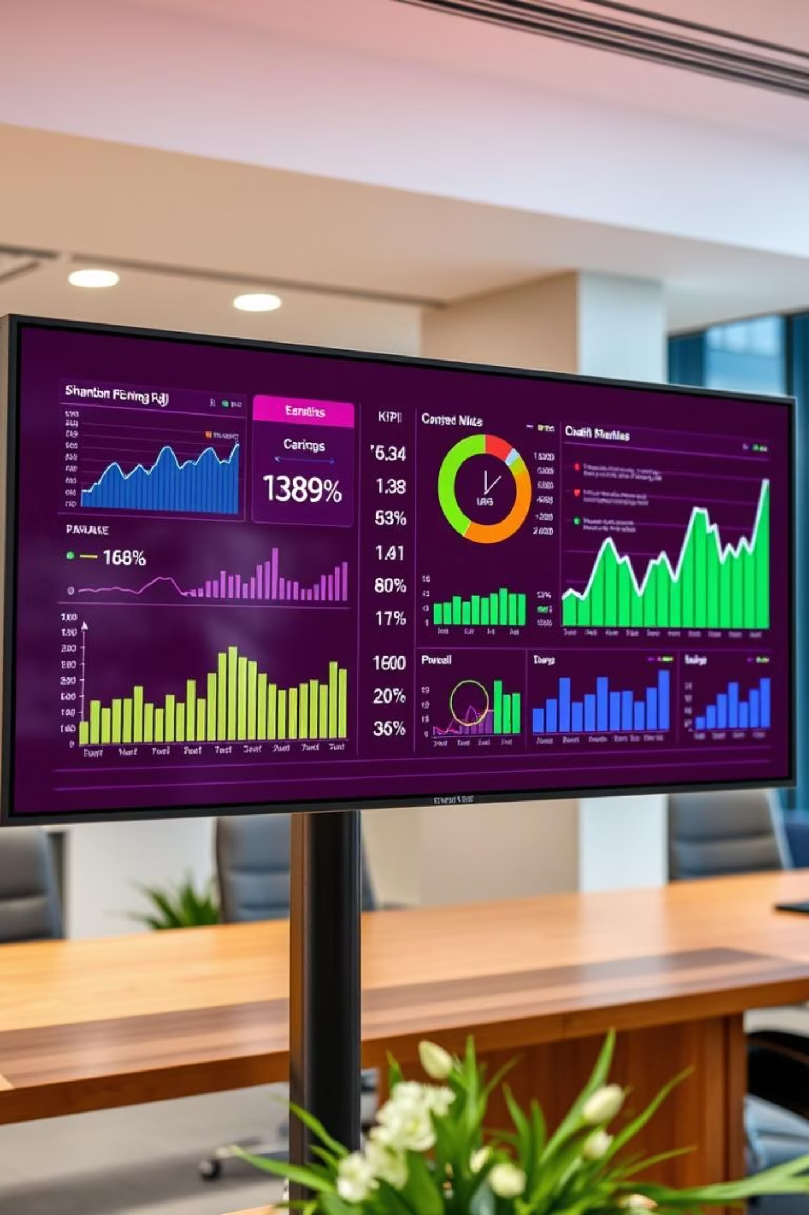
Key Performance Indicators
YTD Sales
Monitor cumulative year-to-date revenue to gauge overall performance.
QTD Sales
Track quarterly sales figures for short-term trend identification.
YTD Products Sold
Analyze the total number of items sold to understand product movement.
YTD Reviews
Assess customer feedback and satisfaction through cumulative reviews.

Slide 4
Data Visualization Requirements
Monthly Sales Trends
Line chart to visualize YTD sales by month for seasonal patterns.
Weekly Performance
Column chart to display YTD sales by week for short-term insights.
Category Overview
Text or heatmap for sales across different product categories.
Top 5 Products (Sales)
Bar chart highlighting key revenue generators by YTD sales.
Top 5 Products (Reviews)
Bar chart identifying top-rated products by YTD customer reviews.

Slide 5
Software & Functionality
Software Used
Key Functionalities
Excel (Latest Version)
Connecting to CSV Files
Power BI (Latest Version)
Data Cleaning Procedures
Robust Data Modeling
Efficient Data Processing
Power Query Integration
Dynamic Date Tables
Time Intelligence Functions
DAX Formula Development

Slide 6








Advanced Analytics & Visualization
Date Functions
Text Functions
Utilizing various date-related calculations for time-series analysis.
Processing and manipulating text data for enhanced insights.
Filter Functions
Calculate Functions
Applying precise filters to focus on specific data segments.
Performing complex calculations for advanced metrics.
YTD & QTD Functions
Custom Sorting
Calculating Year-to-Date and Quarter-to-Date totals.
Implementing unique sorting logic for tailored data views.
Formatting Visuals
Creating Charts
Applying aesthetic and functional formatting to charts.
Generating diverse chart types for compelling data representation.

Slide 7

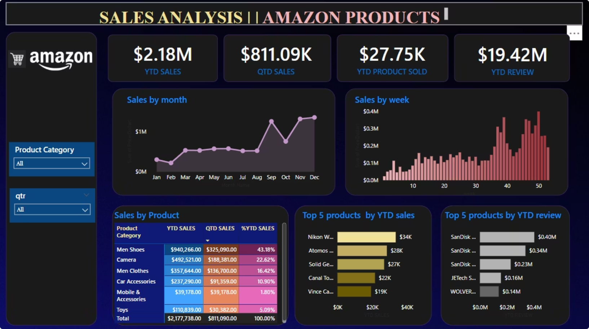
Dashboard Overview
This dashboard provides a comprehensive view of Amazon's YTD sales performance. It integrates all the KPIs and visualizations discussed, enabling quick and informed decision-making.
Further analysis can be conducted by navigating through different sections and applying various filters.

